Slide 1
Welcome to the Island of Misfit Friends where the struggle is real but your friends are not. This wasn’t always the case, but then candy was discovered on the island. People got greedy and the king got mean – to say the least. Now you want off the island. Once the king finds out what is going on, nobody will be able to leave. Be the first and only to escape this sweet and sour paradise.

Slide 2
GOAL
The goal of the game is to collect the four items needed to build a boat – CLOTH, ROPE, WOOD AND TOOLS. In order to obtain each item, you first need to get a bribe card which will tell you the candies needed to bribe the islander to obtain the item. Once you have all four items, you win the game.

Slide 3
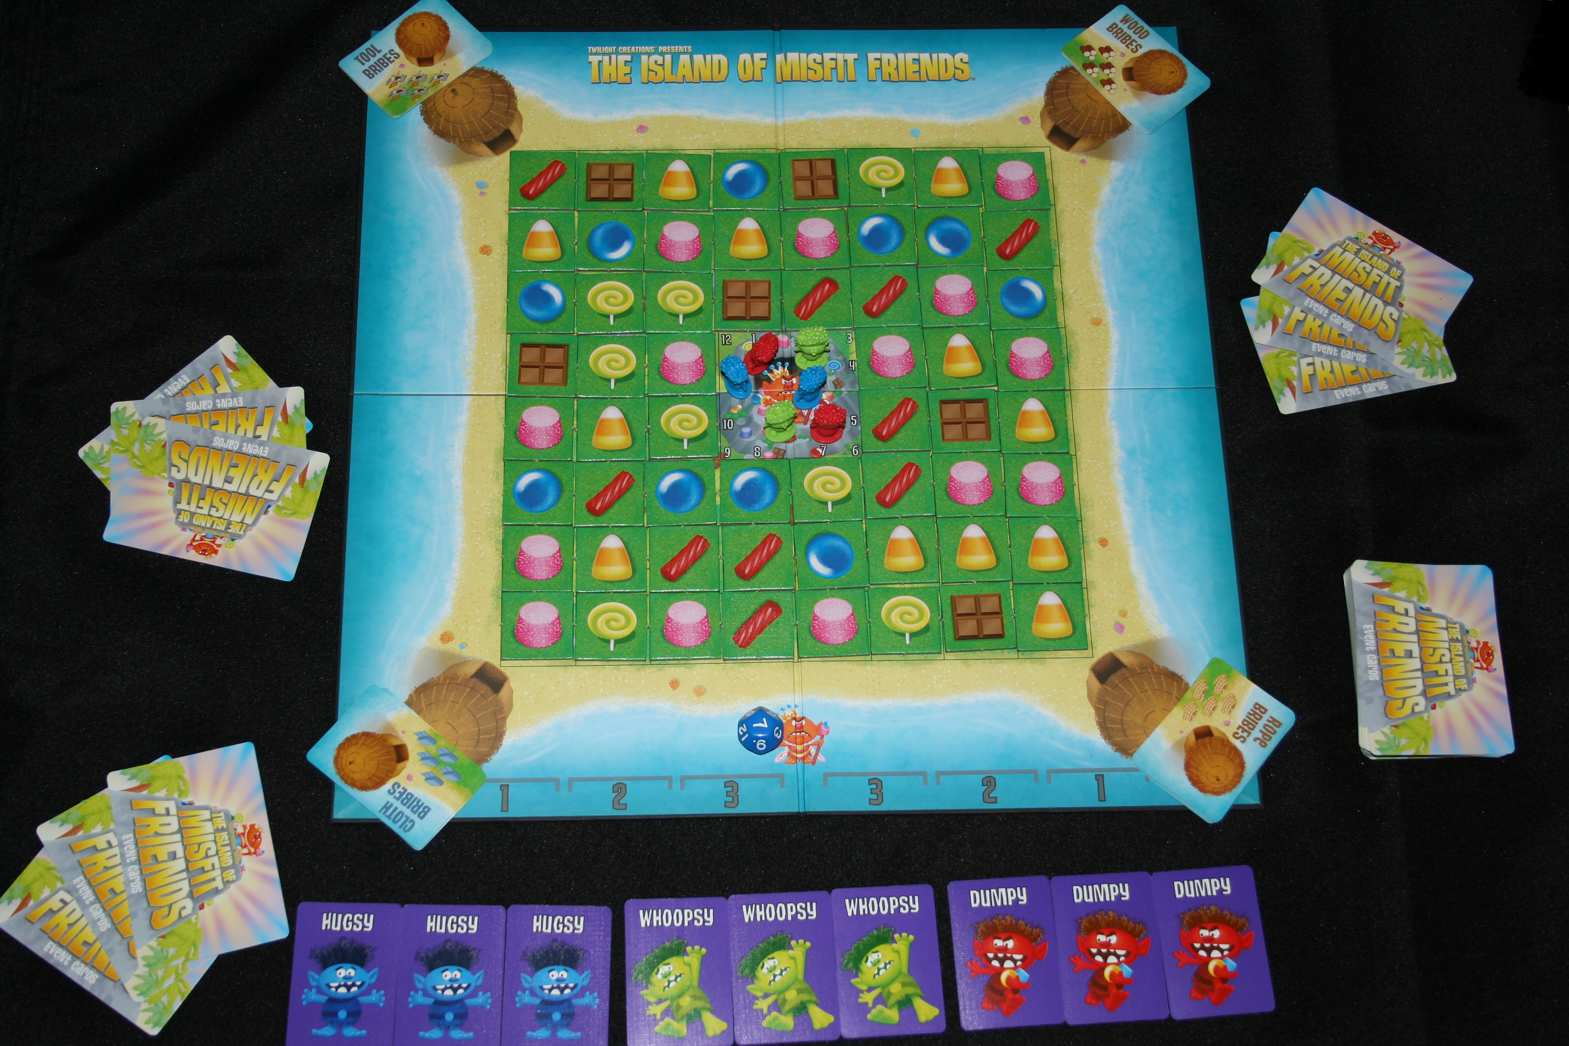
SET-UP
This is how the game is initially set up for a three player game – blue, green and red. Each player gets two player pieces, which are placed in the middle. The movement cards associated with each player are placed into a common deck and shuffled. For a 5-6 player game, one less of each of the player’s movement cards is placed into the common deck and shuffled. The event deck is shuffled and each player dealt 3 cards. The candy tokens are shuffled and placed randomly on the board. The bribe cards are separated into the specific types and each are placed at one of the four huts on the corners of the board.

Slide 4
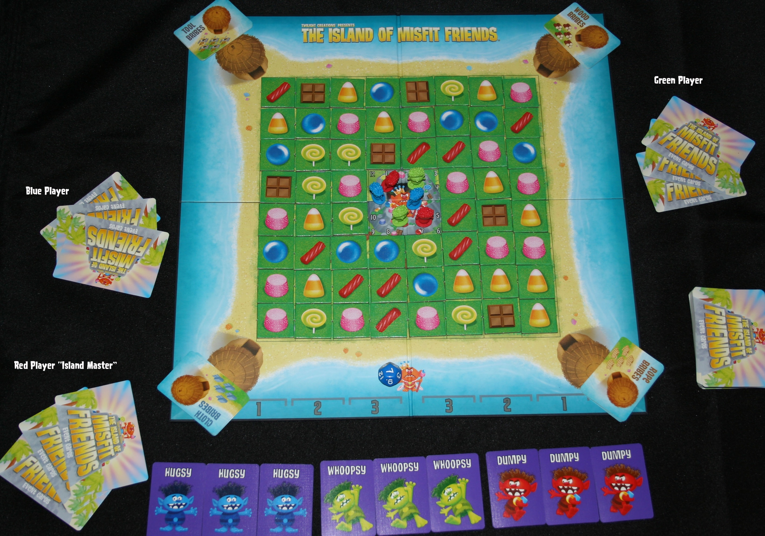
ISLAND MASTER
Choose a player to be the Island Master. They will be responsible for dealing the movement deck along the movement tracker.

Slide 5
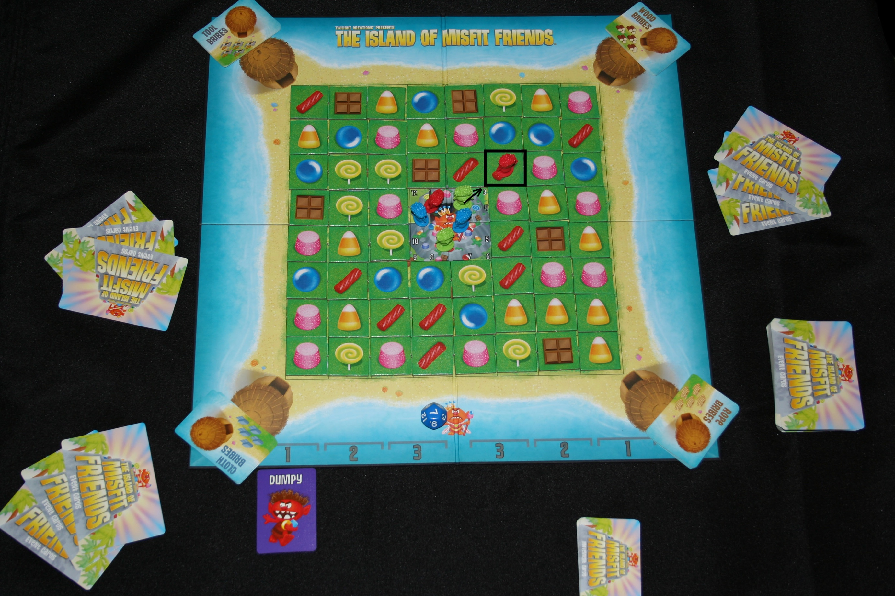
TURN ORDER TRACKER
Island Master shuffles the movement deck and turns over the first card and places it under the “1” on the left side of the movement tracker.
This tells you that the “Red” player gets 1 movement. They can either move a player piece or one candy token 1 space. Here, the red player moved one of their pawns one space.
A player piece can move diagonally or orthogonally. Candy tokens may not move diagonally.

Slide 6
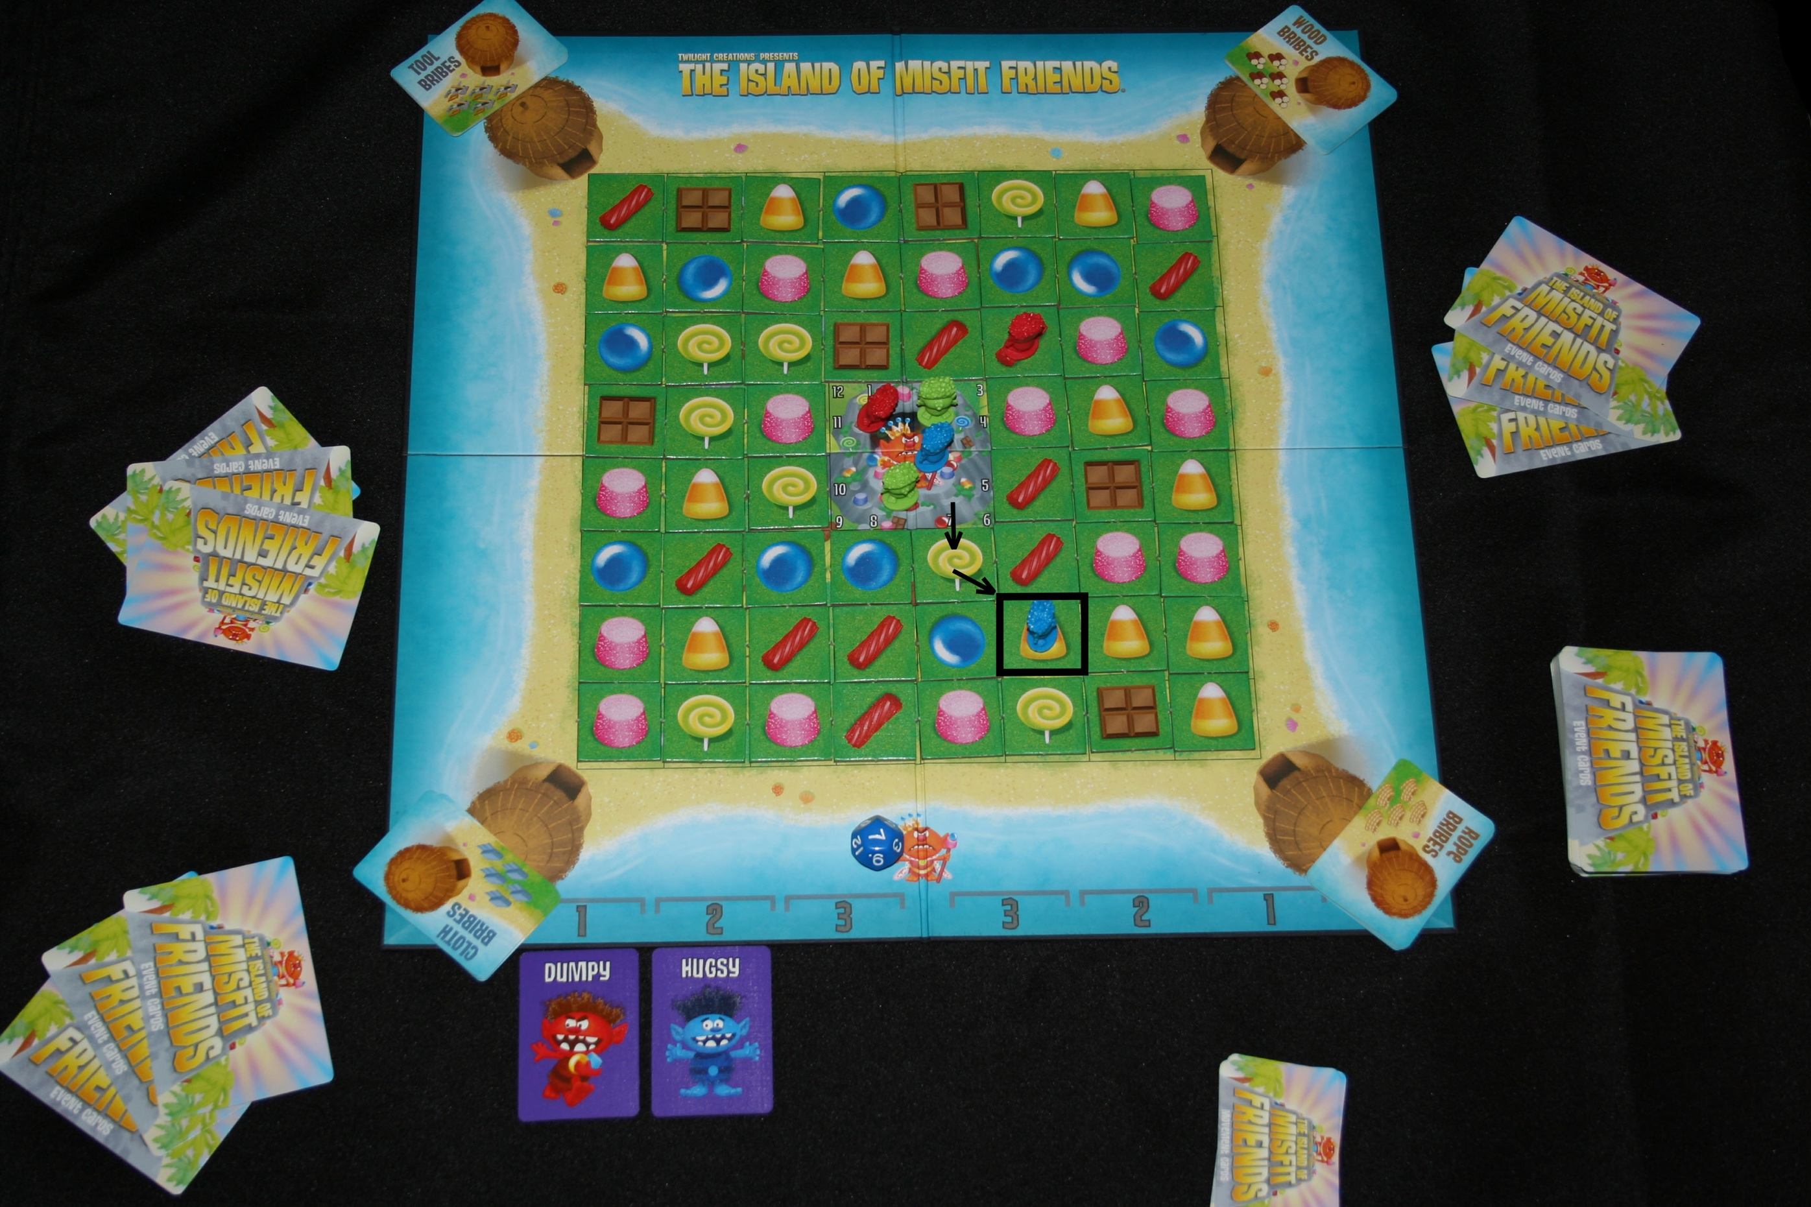
PLAYER MOVEMENT
Here, the “Blue” player gets “2”
movement. They choose to land on the candy corn.

Slide 7
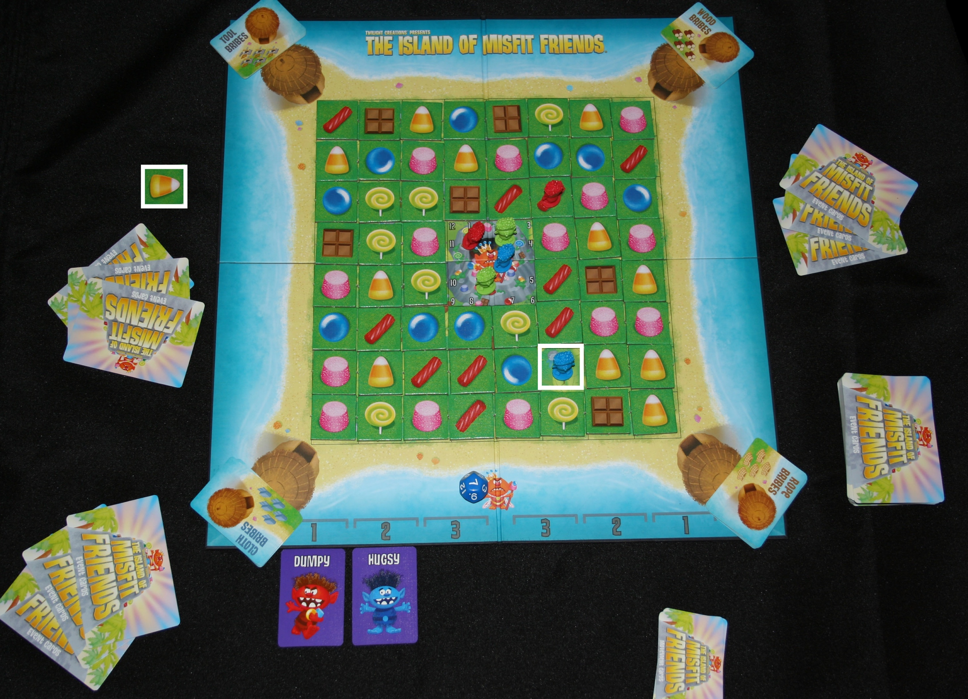
COLLECTING CANDY
Since the “Blue” player ended their movement on a candy corn that is one in a line of three or more of the same candy, they can
collect the candy and place it in front of them.

Slide 8
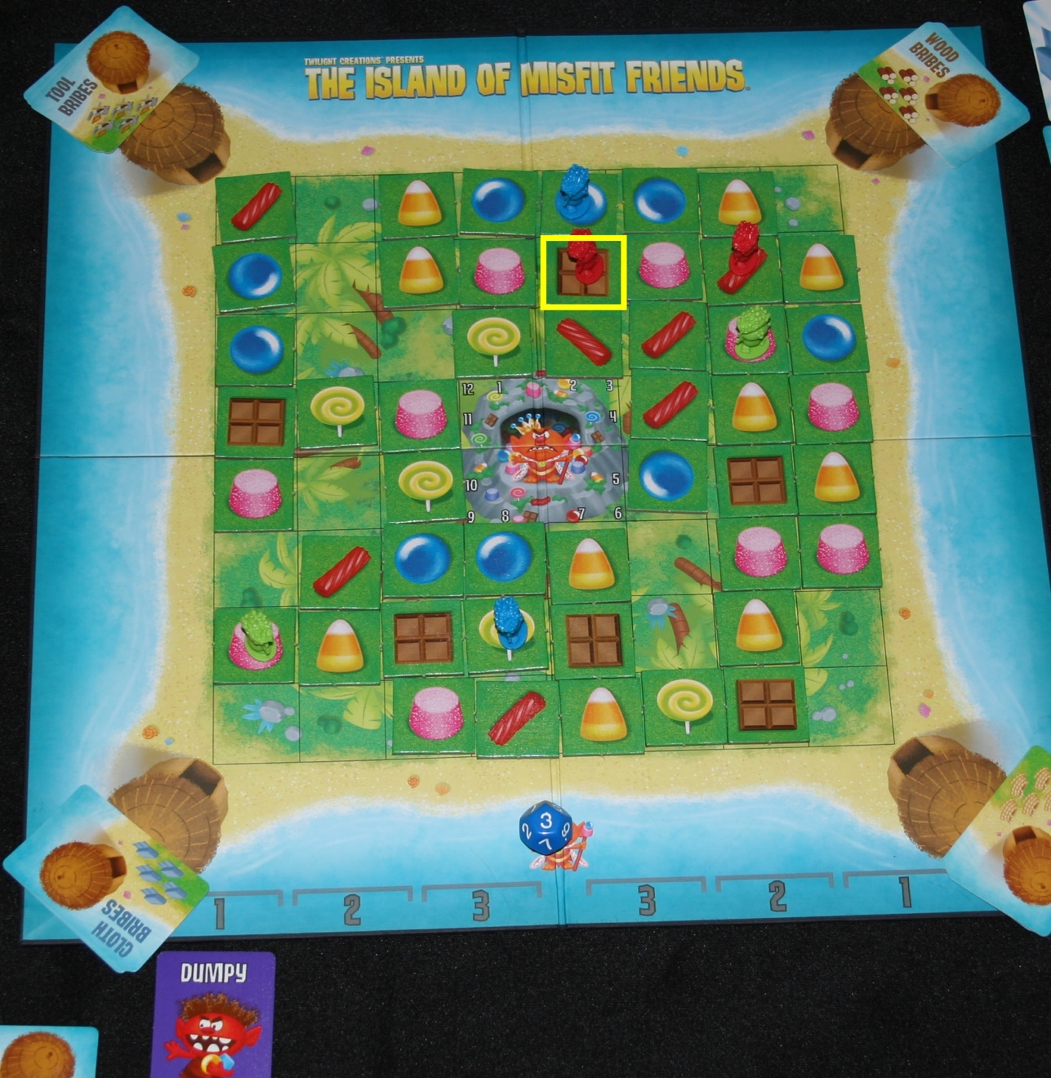
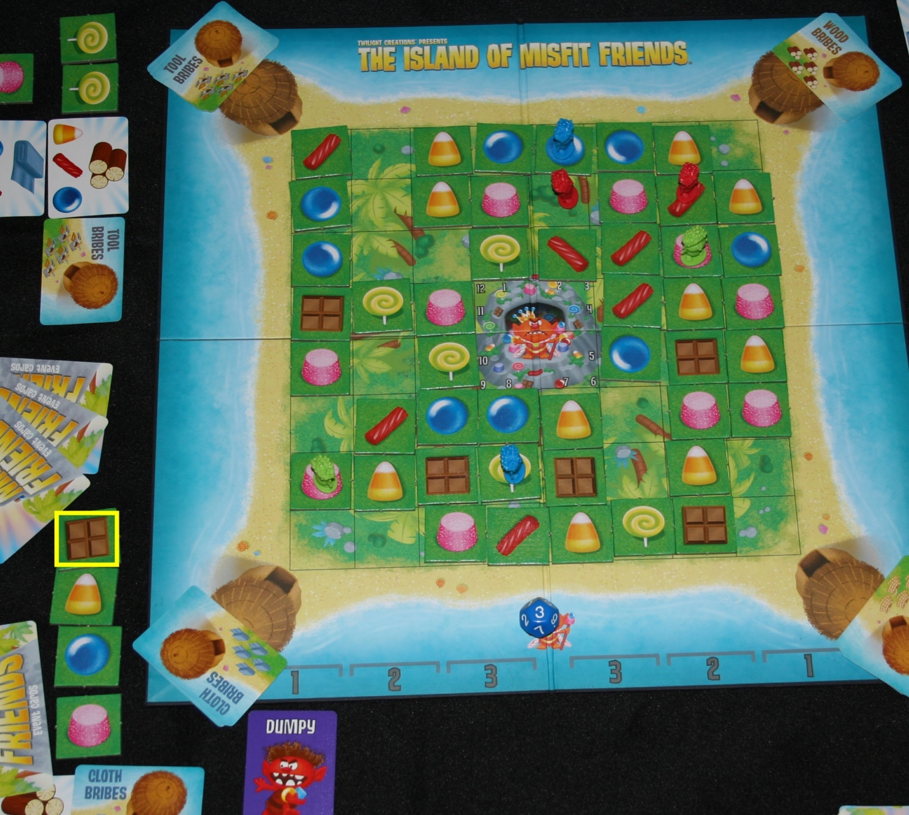
COLLECTING CHOCOLATE TOKENS
Since chocolate is so rare, there is an additional way to collect it. If a player piece is on a chocolate token when it is adjacent to three of the same candies in a line, the player may collect the chocolate token. They may also collect the token as usual if there are three chocolates in a line.

Slide 9
KING ROLL
The king is pretty ticked off at you all collecting his candy. He tosses boulders down the mountain and destroys the candy. Between the first “3” and the second “3”, the king rolls. This occurs when being dealt either way – from left to right or right to left. Roll the die and discard the first candy that corresponds to the number on the die. If there is not one in the first space, continue down that corresponding line to the next available piece and remove it from the board.

Slide 10
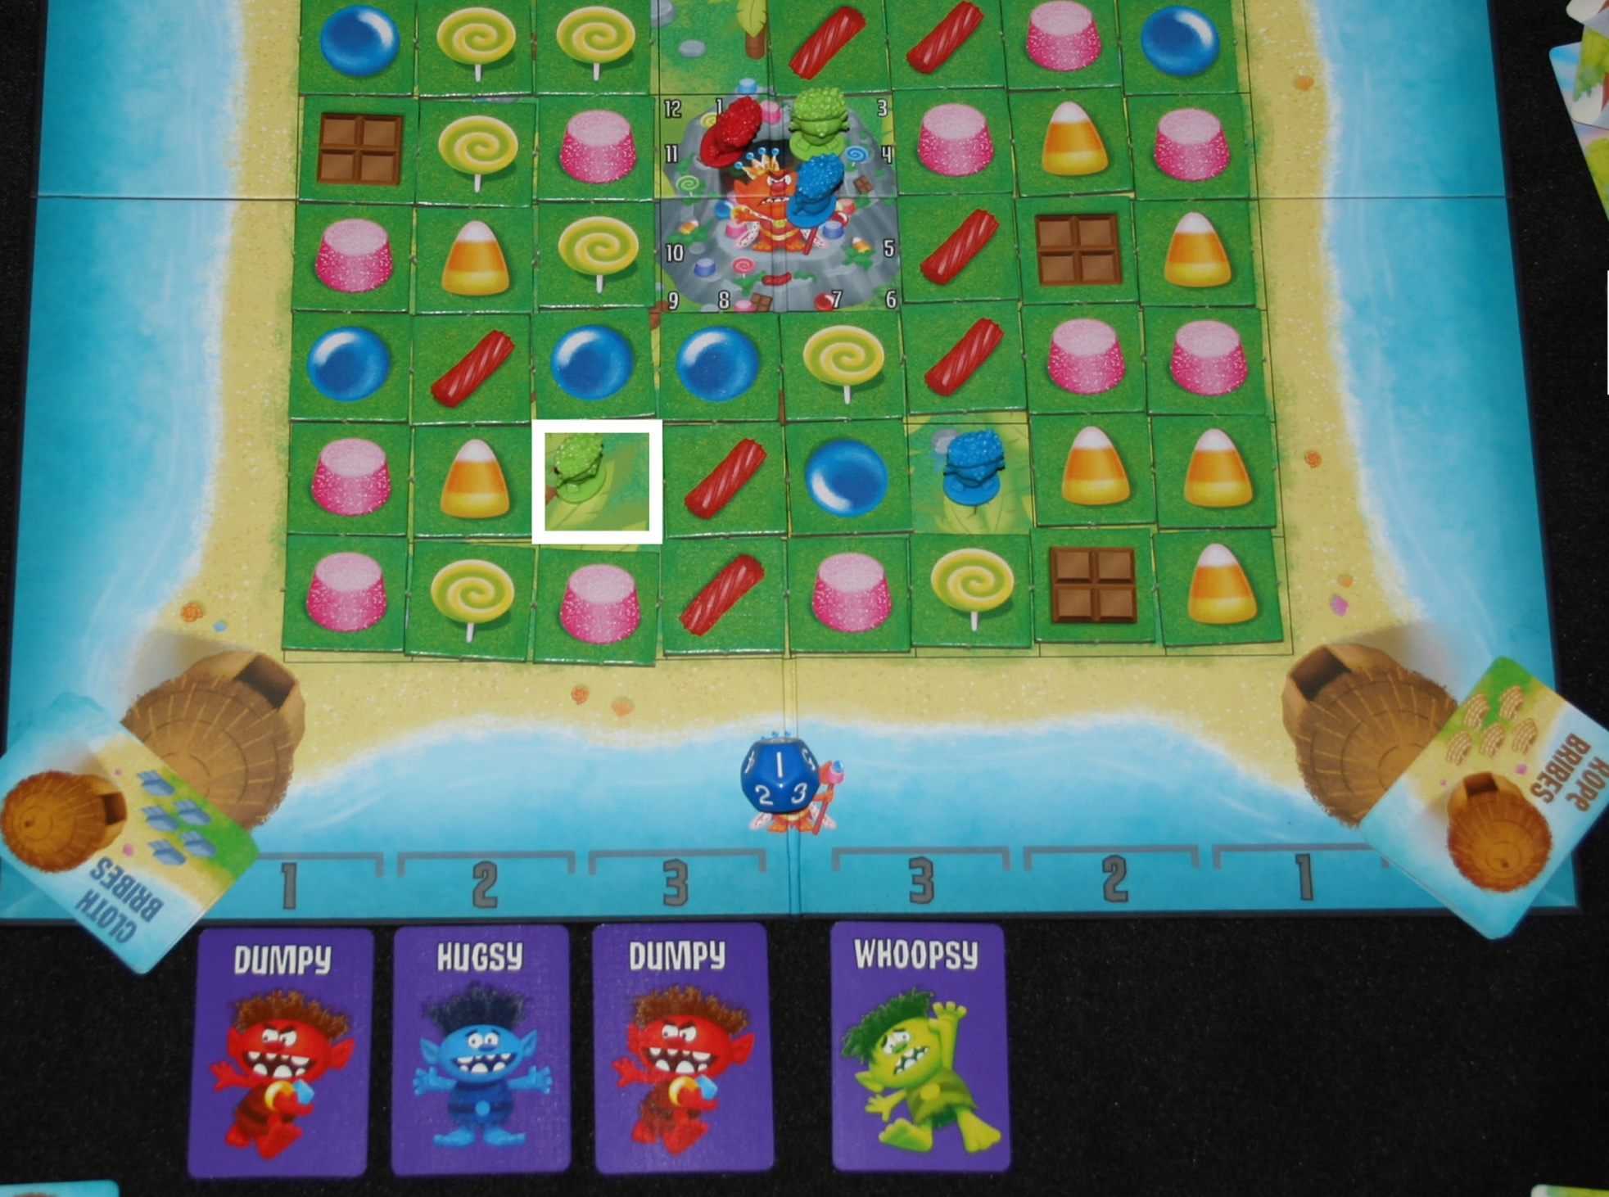
PLAYER MOVEMENT EXAMPLE
Green player moves to a licorice that has three in a line diagonally. They collect the licorice and place it in front of them. All movement has to be used, but you may double back.

Slide 11
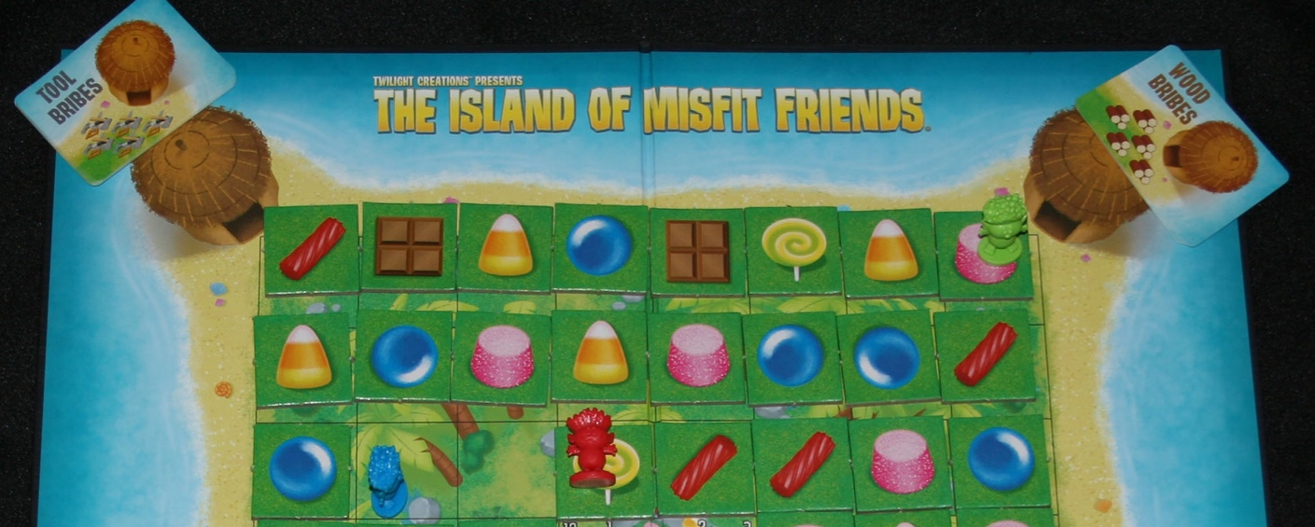
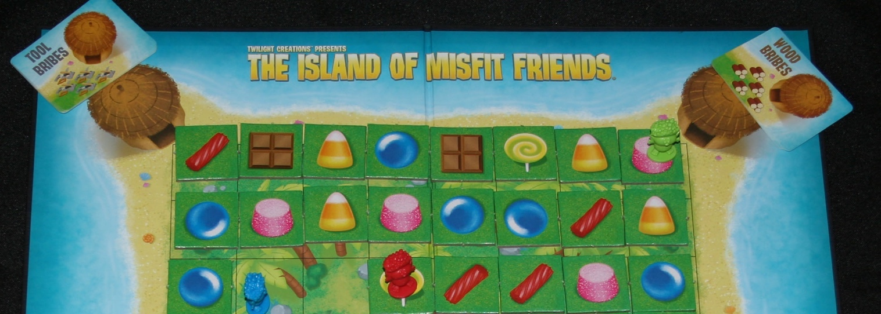
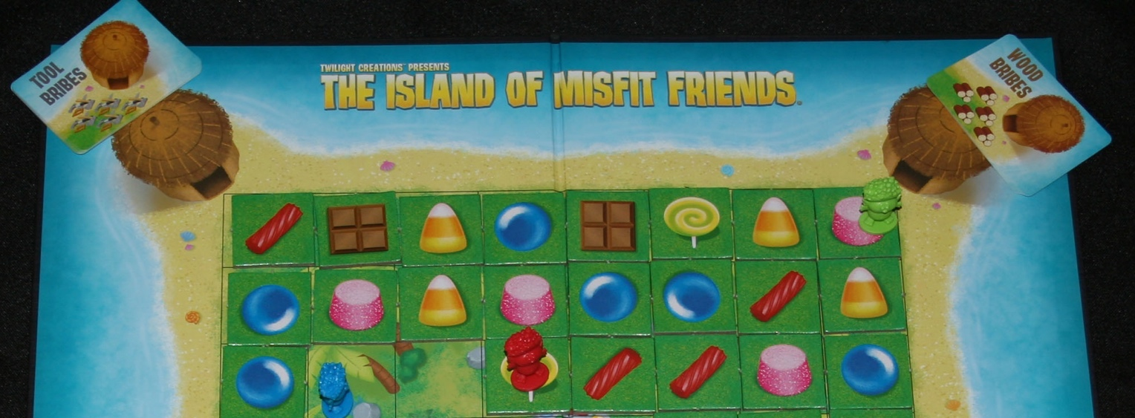
CANDY TOKEN MOVEMENT
When moving a candy token, pick a specific token you want to move and push it in the direction you wish - your whole movement. If you are dealt a “3,” the token must move the whole 3 in the same direction.
It is easiest to separate the row or column that you want to move as in the first picture. Push the token. In this example, the right-most licorice is being moved one square to the left.
The candy corn at the other end will wrap around and be placed next to the licorice.
Finally, push the tokens back together.

Slide 12
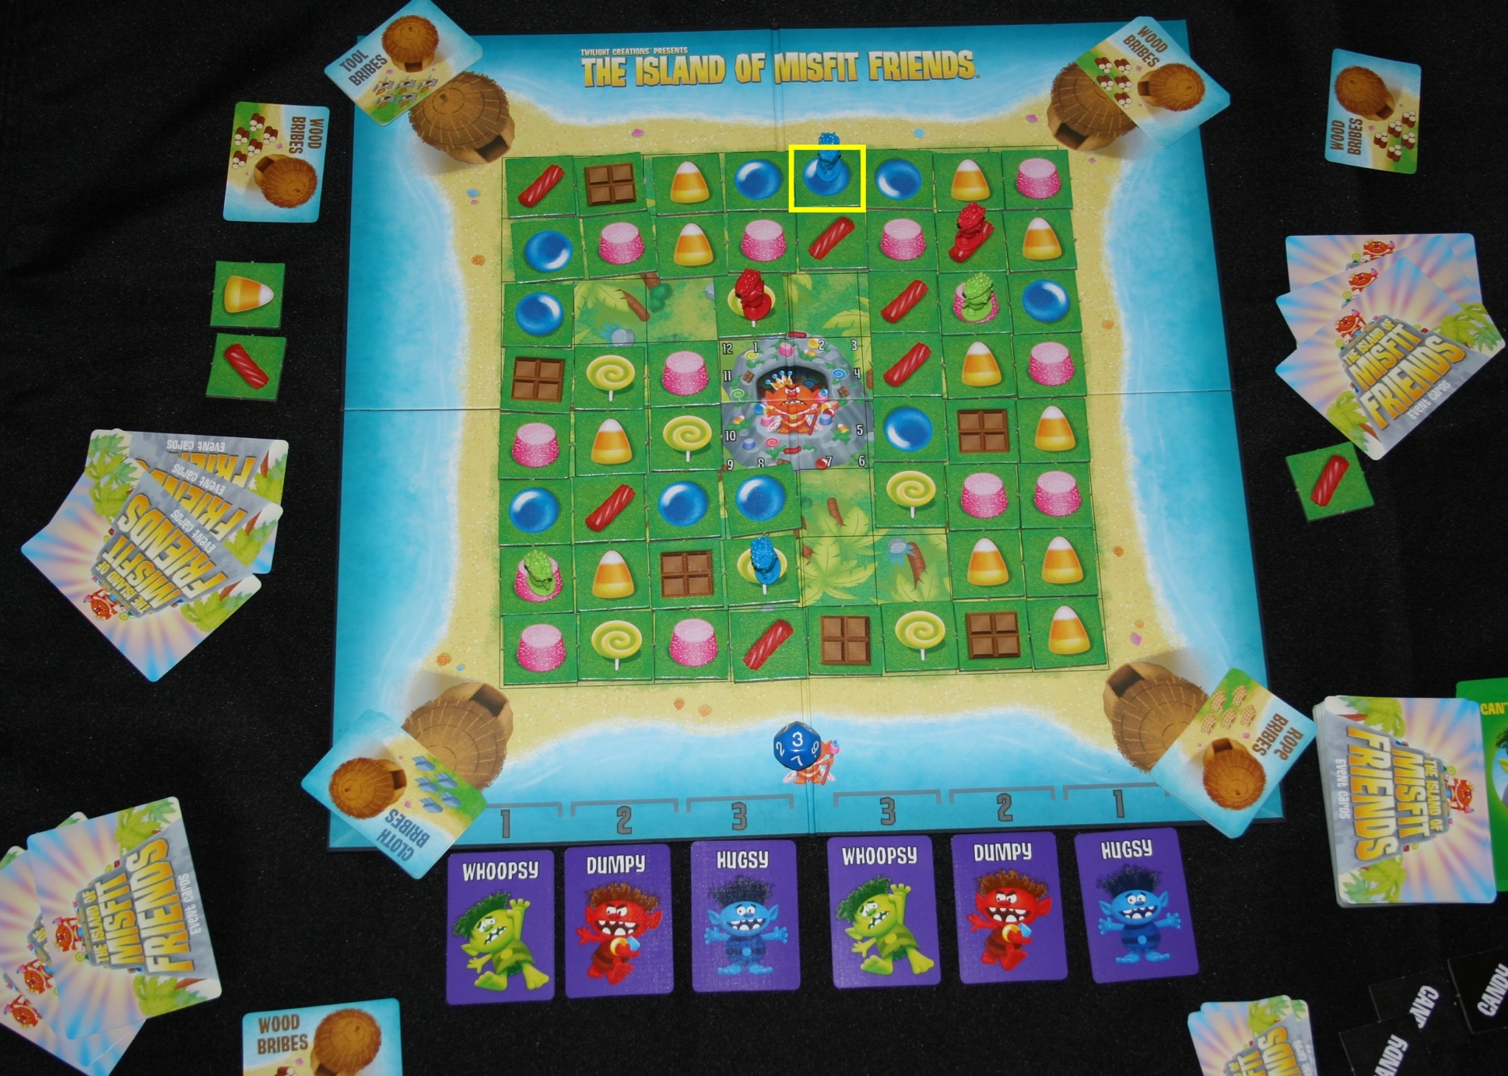
CANDY TOKEN MOVEMENT cont.
The “Blue” player gets a “1” movement. They decide to move the licorice one square allowing alignment of three gumballs in a row. Player pieces remain on the token even as it is being moved. The “Blue” player then collects the gumball.

